Slide 1


Titus Cieslewski, Davide Scaramuzza
Institute of Informatics – Institute of Neuroinformatics
Efficient Decentralized Visual Place Recognition from Full-Image Descriptors
T. Cieslewski, D. Scaramuzza: Efficient Decentralized Visual Place Recognition From Full-Image Descriptors MRS 2017

Slide 2
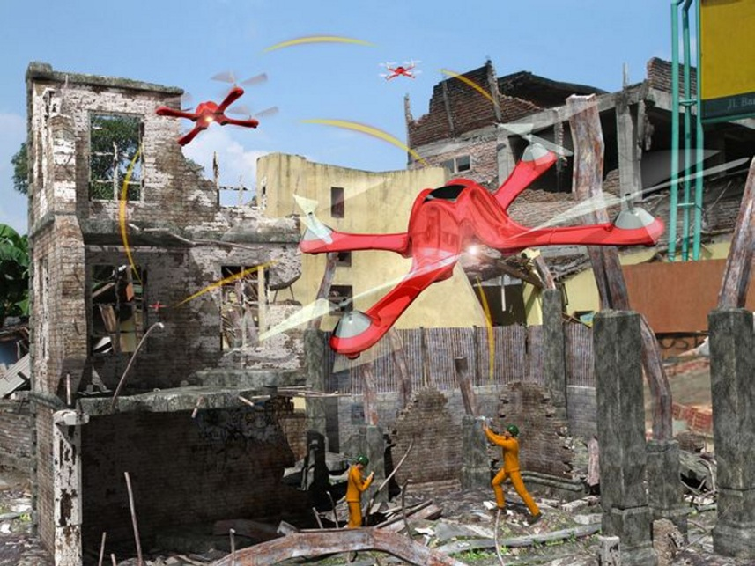
Goal
Decentralized Visual Place Recognition for Decentralized Visual SLAM (sub. ICRA 2018, ArXiv)
Situational awareness for a group of robots
T. Cieslewski, D. Scaramuzza: Efficient Decentralized Visual Place Recognition From Full-Image Descriptors MRS 2017
T. Cieslewski, S. Choudhary, D. Scaramuzza: Data-Efficient Decentralized Visual SLAM ICRA 2018 (submitted), ArXiv

Slide 3
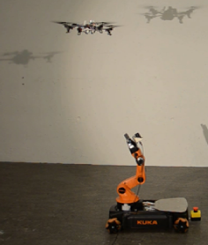
Indirect relative pose measurements
Direct: Measure the other robot’s position directly
[Roumeliotis 2002, Howard 2006, Franchi 2009, Kim 2010, Paull 2015, Choudhary 2016, Halsted 2017, …]
Indirect: Match observations
No extra hardware
More recall than just line of sight
But: Needs communication
Assuming given (can be multi-hop)
T. Cieslewski, D. Scaramuzza: Efficient Decentralized Visual Place Recognition From Full-Image Descriptors MRS 2017

Slide 4
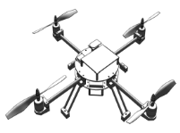
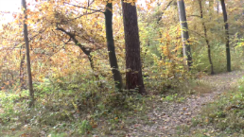
Decentralized Visual Place Recognition
Query everyone?
O(n) per place query
Reduce bandwidth: Pruning [Volkov 2015], dim. Reduction [Lynen 2015], alt. representation [Jacobson 2017], object-based [Choudhary 2017]
T. Cieslewski, D. Scaramuzza: Efficient Decentralized Visual Place Recognition From Full-Image Descriptors MRS 2017

Slide 5
Decentralized Visual Place Recognition
We can do better!
O(1) per place query
T. Cieslewski, D. Scaramuzza: Efficient Decentralized Visual Place Recognition From Full-Image Descriptors MRS 2017

Slide 6
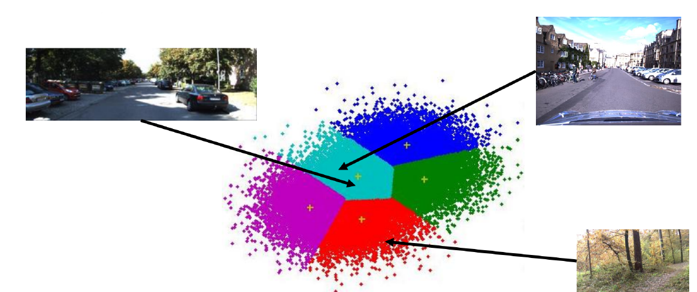
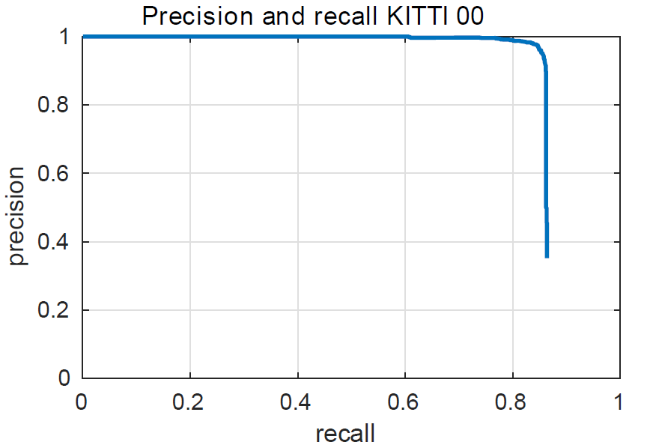

Place recognition method
NetVLAD: State-of-the-art CNN descriptor [Arandjelović 2016]
Converts images $I_{i}$ into vectors $\vec{v_{i}}$
Two images considered from same place if ${\left\|\vec{v_{a}}−\vec{v_{b}}\right\|}_{ℓ2}<ε$
Precision-recall metric, area-under-curve
Here, mainly evaluated on the KITTI dataset [Geiger 2013]
T. Cieslewski, D. Scaramuzza: Efficient Decentralized Visual Place Recognition From Full-Image Descriptors MRS 2017

Slide 7
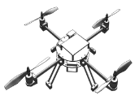
Distributed Hash Tables (DHTs)
Developed by the distributed computing community in the early 2000s (e.g. [Stoica 2001])
Efficient Key-Value lookup in a distributed map
Key insight: Deterministic assignment of keys to peers: Report new data to and query only one peer
000
111
001
110
010
101
011
100
T. Cieslewski, D. Scaramuzza: Efficient Decentralized Visual Place Recognition Using a Distributed Inverted Index RA-L 2017
T. Cieslewski, D. Scaramuzza: Efficient Decentralized Visual Place Recognition From Full-Image Descriptors MRS 2017

Slide 8
Decentralizing Visual Place Recognition
Cluster NetVLAD space, assign clusters to robots
Send given query only to robot assigned to corresponding cluster
Place recognition constant, rather than linear in robot count!
Clustering trained on Oxford Robotcar Dataset [Maddern 2016]
T. Cieslewski, D. Scaramuzza: Efficient Decentralized Visual Place Recognition From Full-Image Descriptors MRS 2017
Notes:
Why linear: At each time there is one query sent by every robot

Slide 9
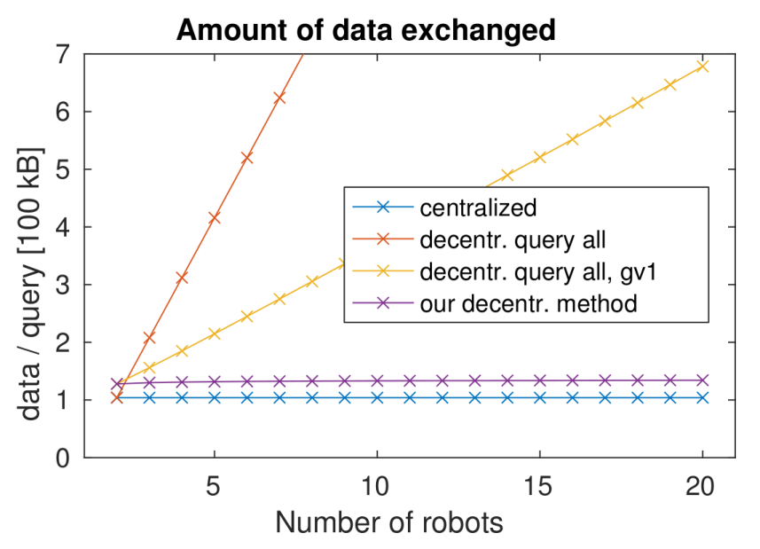
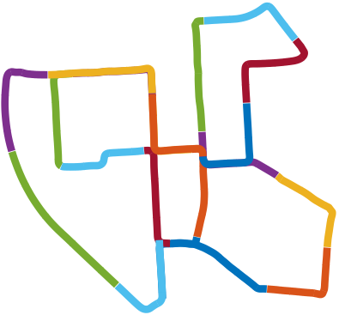
Result: Bandwidth reduction!
Up to n-fold bandwidth reduction VS querying all
512 Bytes per query (without geometric verification)
T. Cieslewski, D. Scaramuzza: Efficient Decentralized Visual Place Recognition Using a Distributed Inverted Index RA-L 2017
T. Cieslewski, D. Scaramuzza: Efficient Decentralized Visual Place Recognition From Full-Image Descriptors MRS 2017

Slide 10
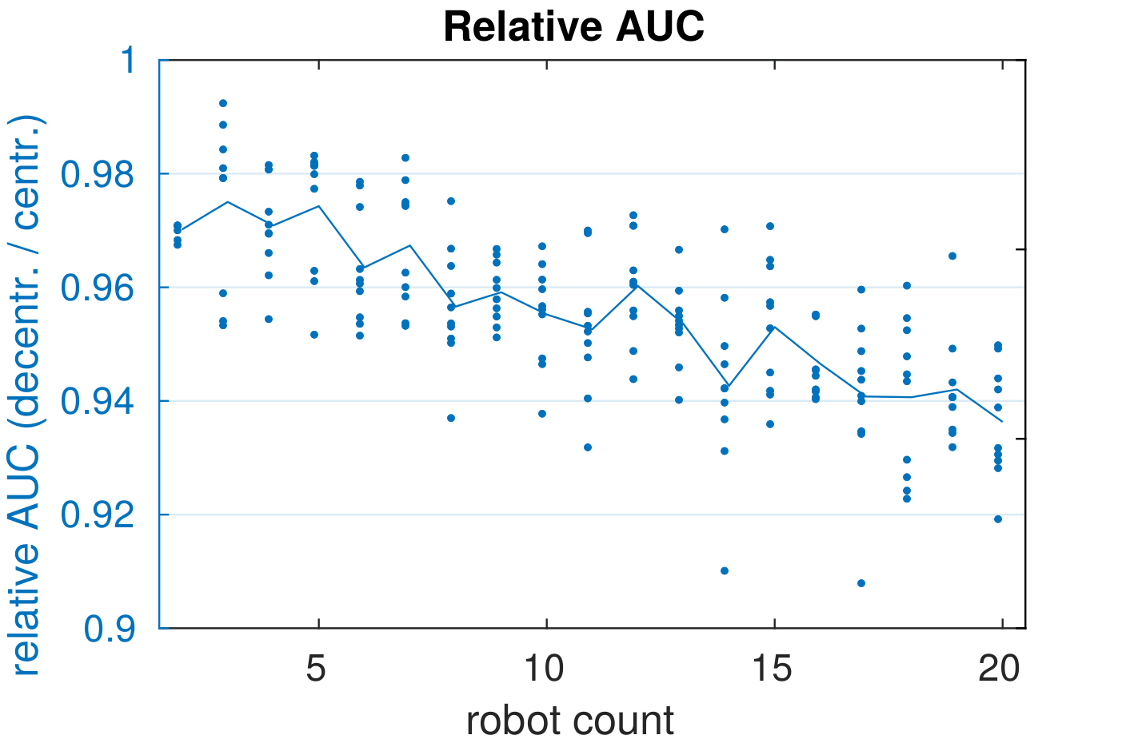
Side effect 1: Reduced recall
Place recognition across cluster boundaries fails
More robots = more cluster boundaries = less recall
T. Cieslewski, D. Scaramuzza: Efficient Decentralized Visual Place Recognition From Full-Image Descriptors MRS 2017

Slide 11
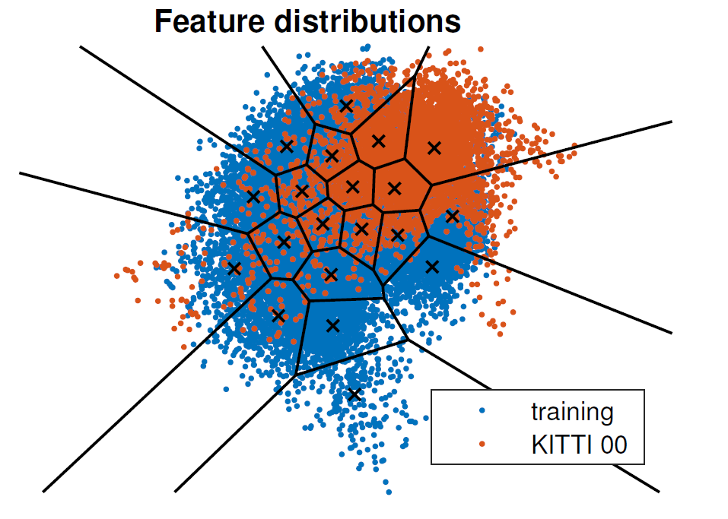
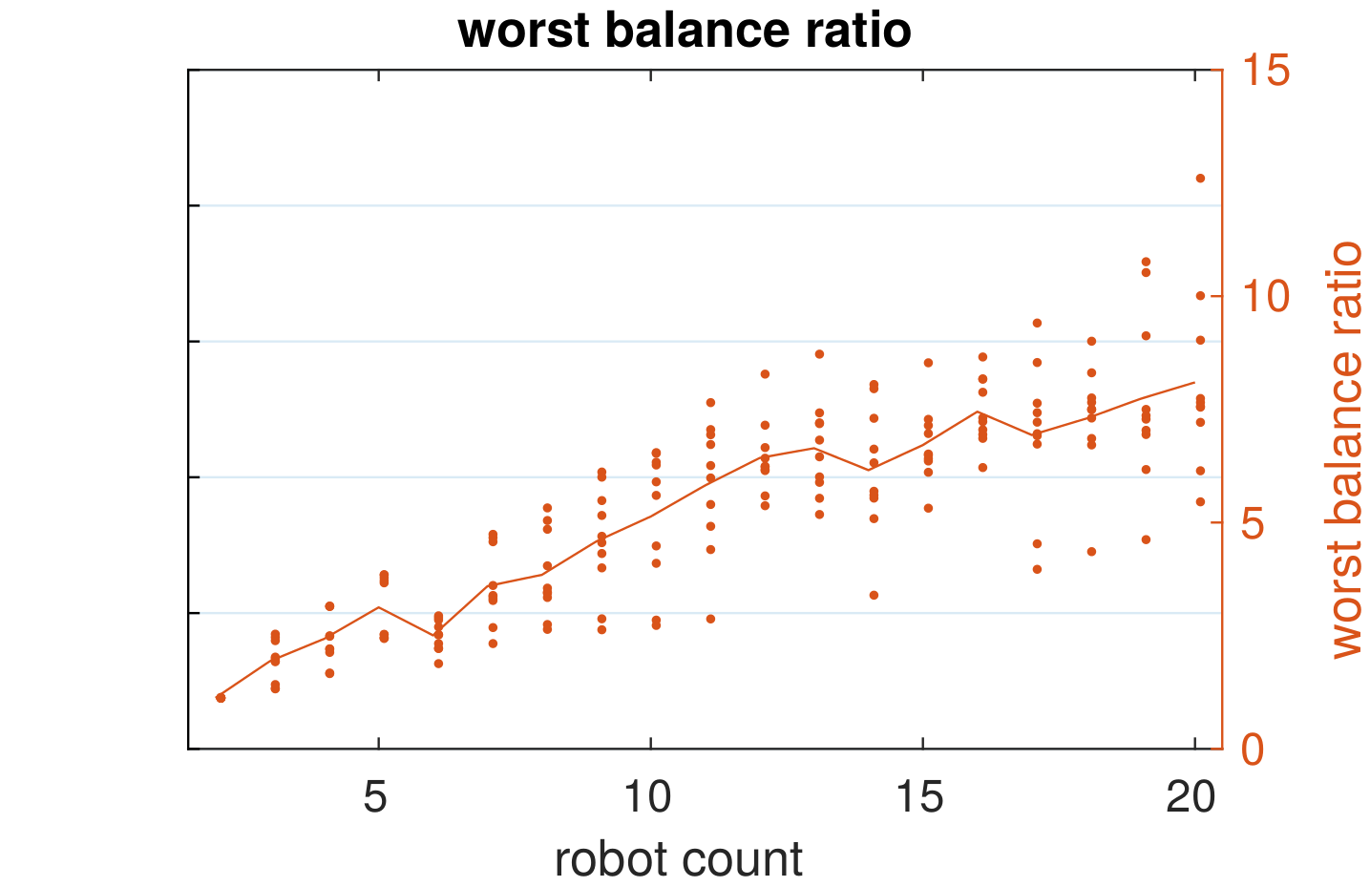
Side effect 2: Load imbalance
If evaluation data covers only a subset of the cluster training data…
… not all robots receive queries
Problem if environment not known a priori
T. Cieslewski, D. Scaramuzza: Efficient Decentralized Visual Place Recognition From Full-Image Descriptors MRS 2017

Slide 12
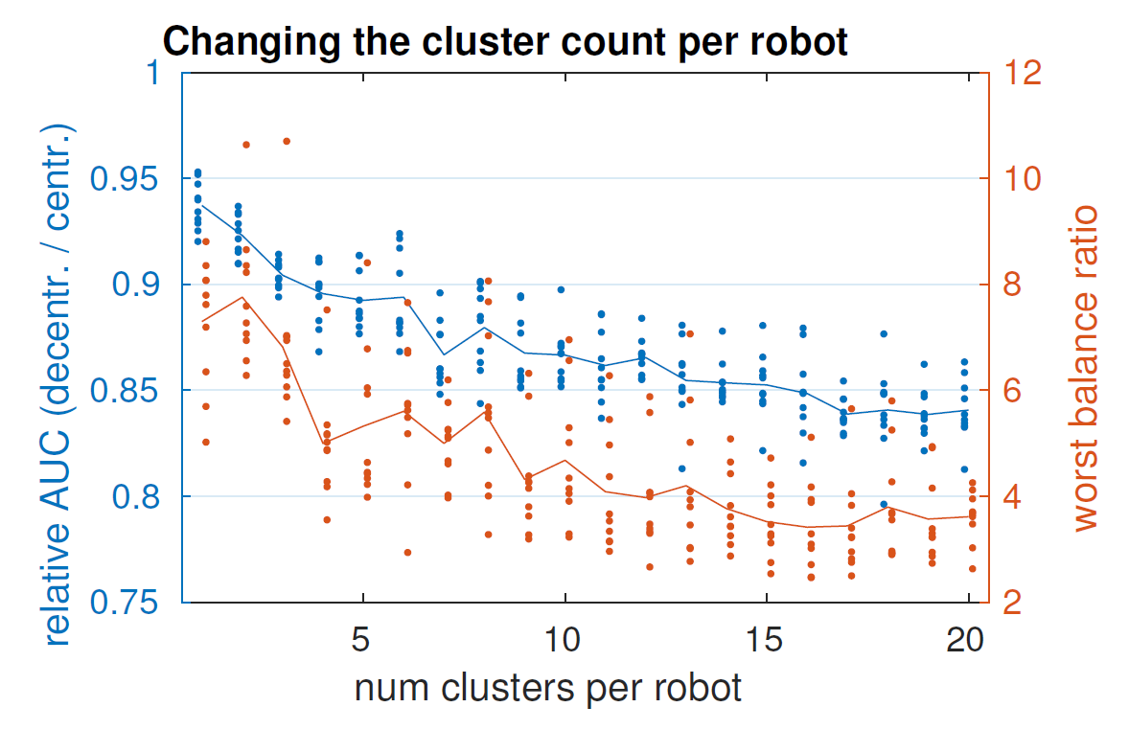
Trading off recall with balancing
“Solution”: Have several clusters per robot, mix uniformly
More clusters per robot = better balancing, but more cluster boundaries = reduced recall
T. Cieslewski, D. Scaramuzza: Efficient Decentralized Visual Place Recognition From Full-Image Descriptors MRS 2017

Slide 13
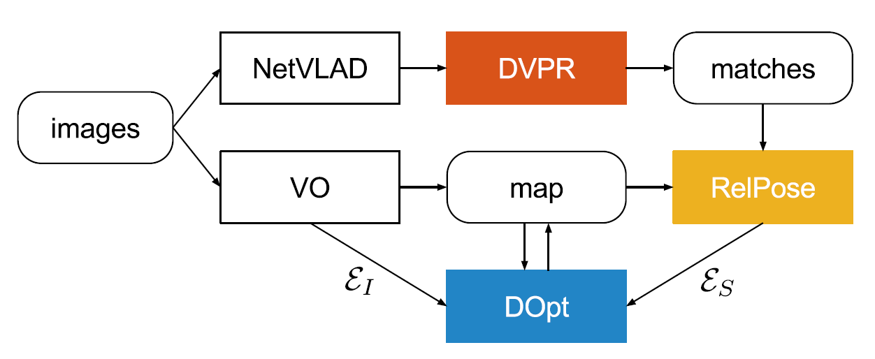
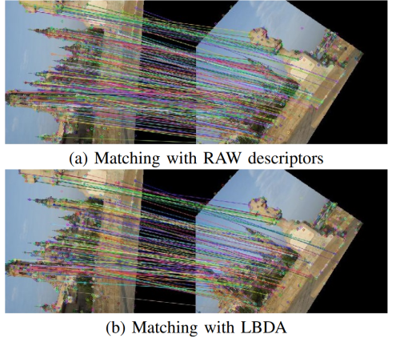
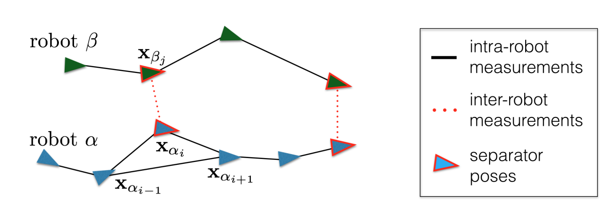
As part of decentralized Visual SLAM
Decentralized Visual SLAM:
RelPose: Get actual SE3 Transform between cameras [Tardioli 2015]
DOpt: Decenetralized Pose Graph Optimization [Choudhary 2016]
T. Cieslewski, S. Choudhary, D. Scaramuzza: Data-Efficient Decentralized Visual SLAM ICRA 2018 (submitted), ArXiv

Slide 14
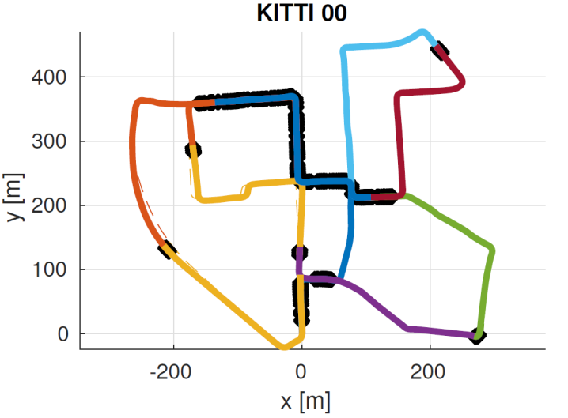
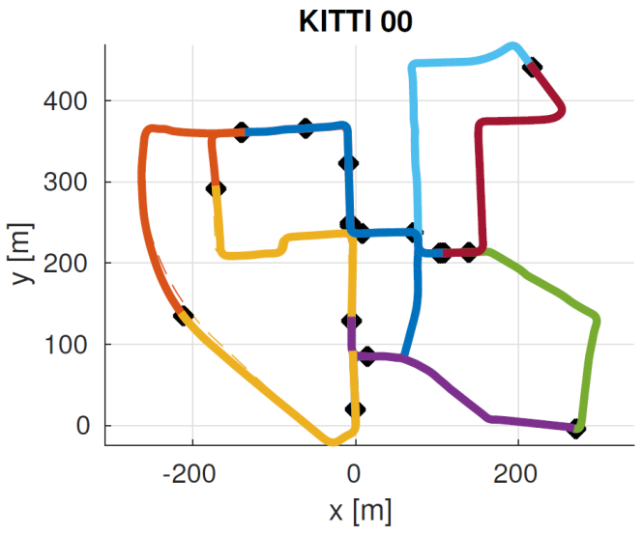
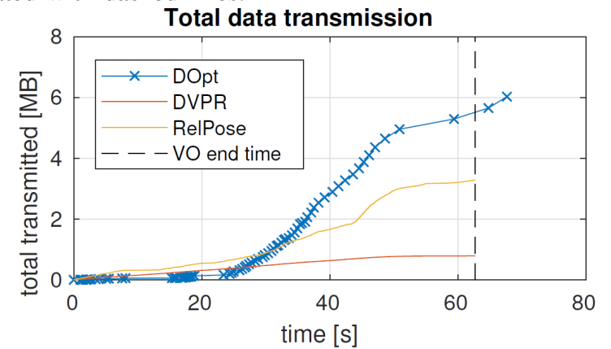
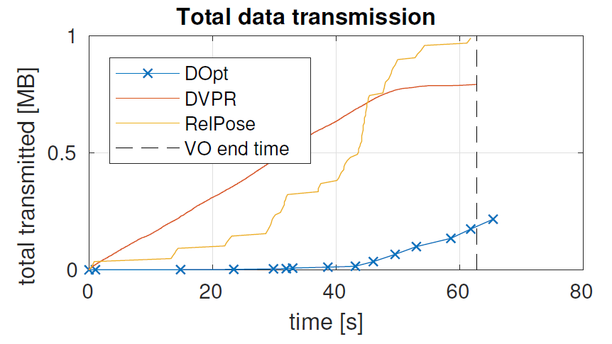
Decentralized Visual SLAM: Results
Skip matches
Ten robots, visual place recognition, optimization – 2MB transmitted!
T. Cieslewski, S. Choudhary, D. Scaramuzza: Data-Efficient Decentralized Visual SLAM ICRA 2018 (submitted), ArXiv

Slide 15





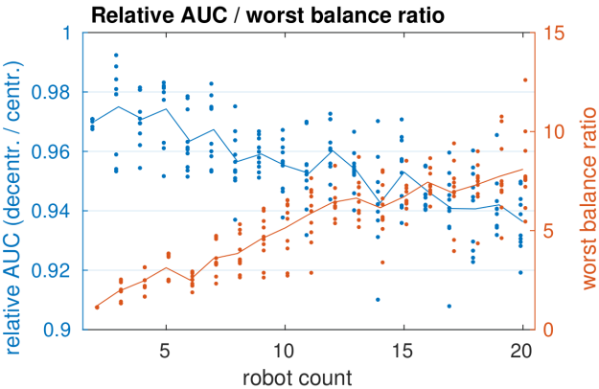


To summarize…
For decentralized SLAM
Query only one, not all other robots
Recall slightly affected
Trade-off with load balancing
Deployed in a full decentralized SLAM system
T. Cieslewski, D. Scaramuzza: Efficient Decentralized Visual Place Recognition From Full-Image Descriptors MRS 2017
T. Cieslewski, S. Choudhary, D. Scaramuzza: Data-Efficient Decentralized Visual SLAM ICRA 2018 (submitted), ArXiv

