Slide 1
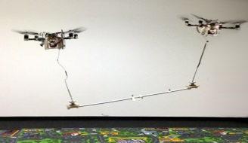
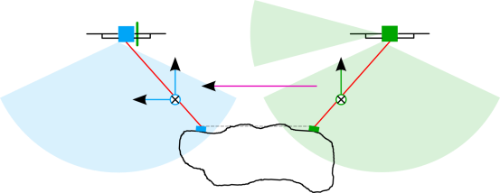
Dynamic Collaboration without Communication:
Vision-Based Cable-Suspended Load Transport with Two Quadrotors
Michael Gassner, Titus Cieslewski (titus@ifi.uzh.ch), Davide Scaramuzza
Premise
Perception and Control
The goal is to transport a load that is too heavy for just one quadrotor. How do humans achieve collaborative transport? As it turns out, not much communication is needed for this.
Both leader and follower are equipped with a downward facing fisheye camera that they use for quad state estimation (fused together with an IMU) as well as tracking the load using a marker on the gripper. The follower furthermore has a forward facing pinhole camera for tracking an April Tag that is mounted on the back of the leader. All sensing and computing is done on-board.
Leader and follower independently control their respective gripper pose as if it were a single pendulum (LQR slung-load controller). To allow the leader to lead, the follower only exerts control laterally to the moving direction (Rule 2). For rule 1), the follower applies simple visual servoing according to its observation of the leader’s April Tag.
Approach
One can think of our approach as splitting up the degrees of freedom of the load among the robots. The leader controls the position (x, y, z) of the load while the follower controls pitch and yaw of the load. To eliminate explicit communication, the follower has two rules:
Visually track altitude and moving direction of the leader
Don’t move laterally.
Results
Using a motion capture system, we measure the full system state during the execution of a simple trajectory given only to the leader. 11/13 test runs succeed, the two failures occur at the level of perception. When compensating for oscillations of the load, the follower deviates laterally 11cm on average on a 3.3m trajectory. The follower is able to track the leader altitude typically within 5-10 cm. Note that this succeeds even if the leader’s altitude estimation is faulty.

